Slide 1


Slide 2
Table of contents
01
02
03
04
Our Team
Idea
Process
Used technologies

Slide 3
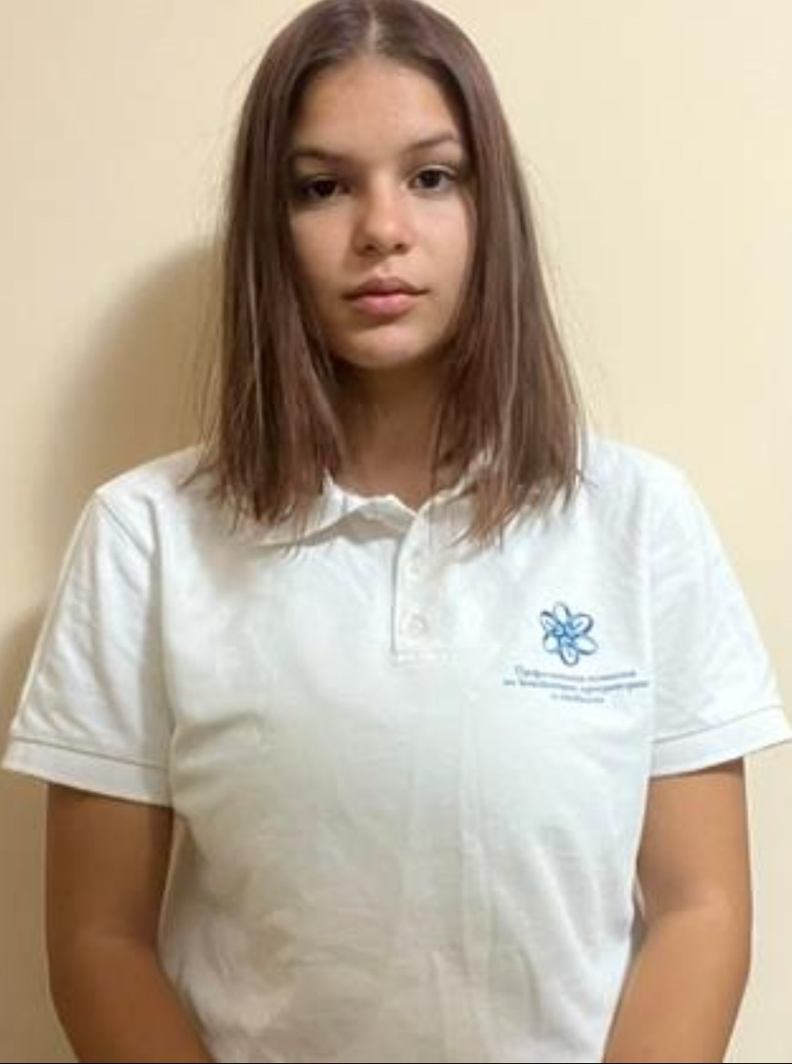
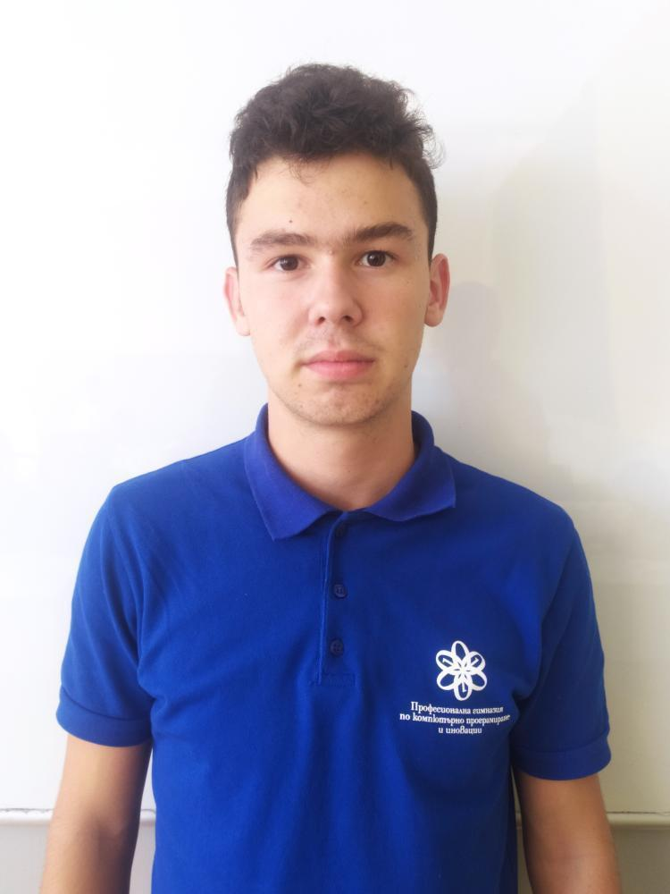
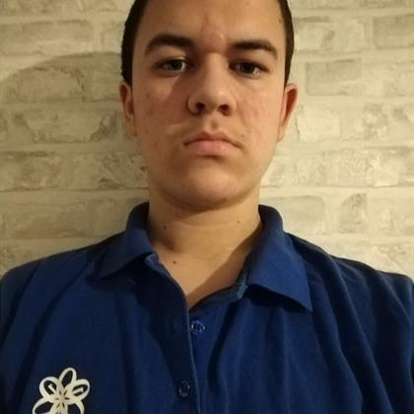
Our team
Nikoleta Ruseva
Kaloyan Georgiev
Atanas Atanasov
Scrum Trainer
Back-end developer
Back-end developer

Slide 4
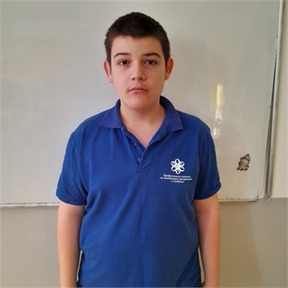
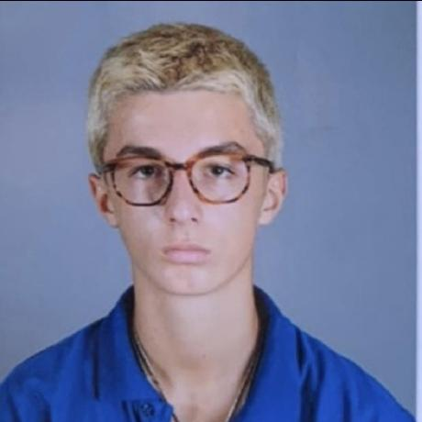
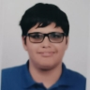
Our team
Rumen Parvanov
Aleksandur Stanev
Veselin Todorov
Back-end developer
Back-end developer
QA Engineer

Slide 5

Idea

Slide 6
Process
Organization
Decide on the idea
Development
Presentation

Slide 7







Used technologies

Slide 8

Let’s jump to the app

